Slide 1

Mastery Project
Customer Segmentation Analysis for Travel Tide Platform
Carolina Cozzi
12th April 2025

Slide 2
Introduction
Methodology
Aim of the analysis:
Segment users to create personalized engagement strategies based on behavioral and demographic patterns.
Data cleaning (EDA) & outliers
Scaling & Dimensions reduction
Unsupervised Machine learning
(k-means)

Slide 3
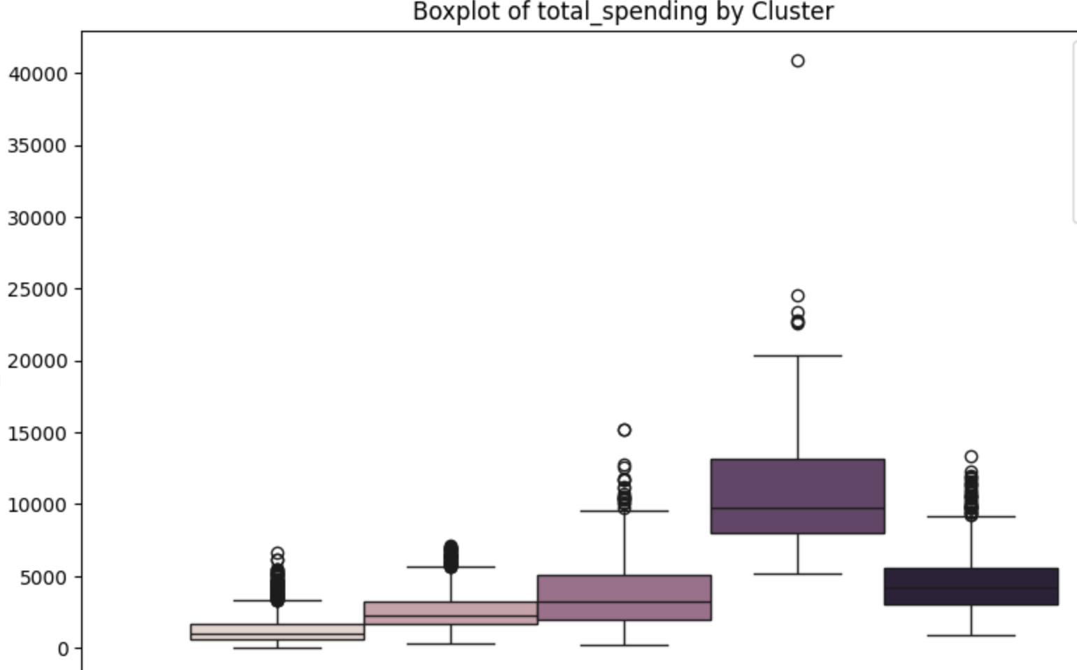
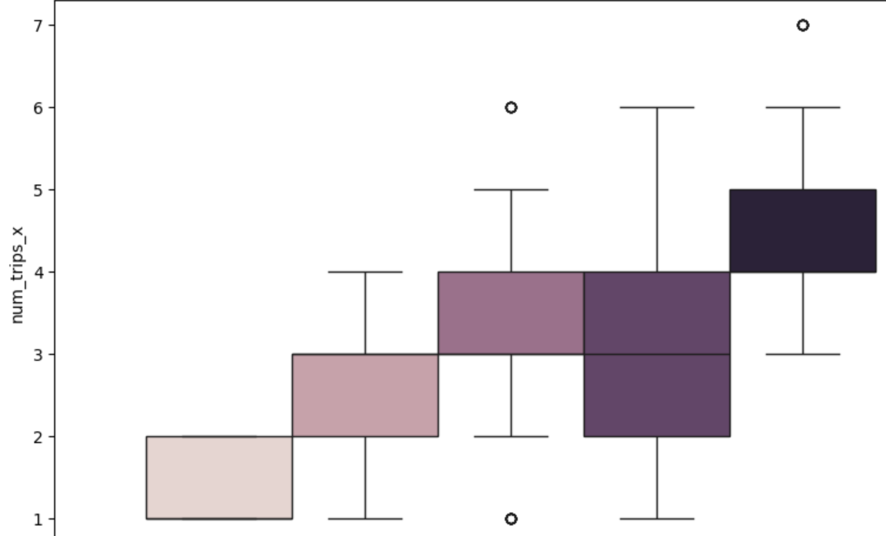
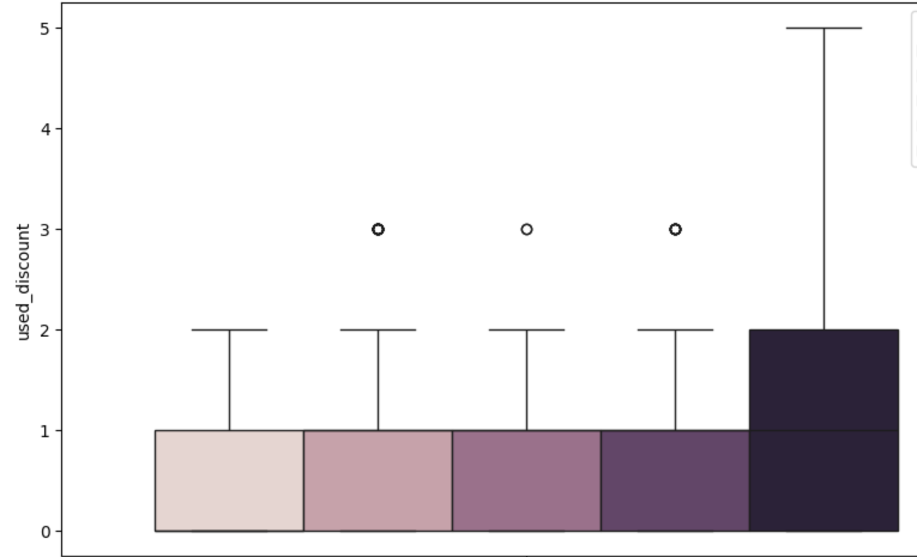
Results: Traveling behaviour
Low Engagement (Cluster 0)
Total spending
Moderate Behavior
(Cluster 1)
High Spenders (Cluster 3)
High Interest
(Cluster 2)
Frequent Travelers
(Cluster 4)
Trip number
Discount use
Clusters

Slide 4
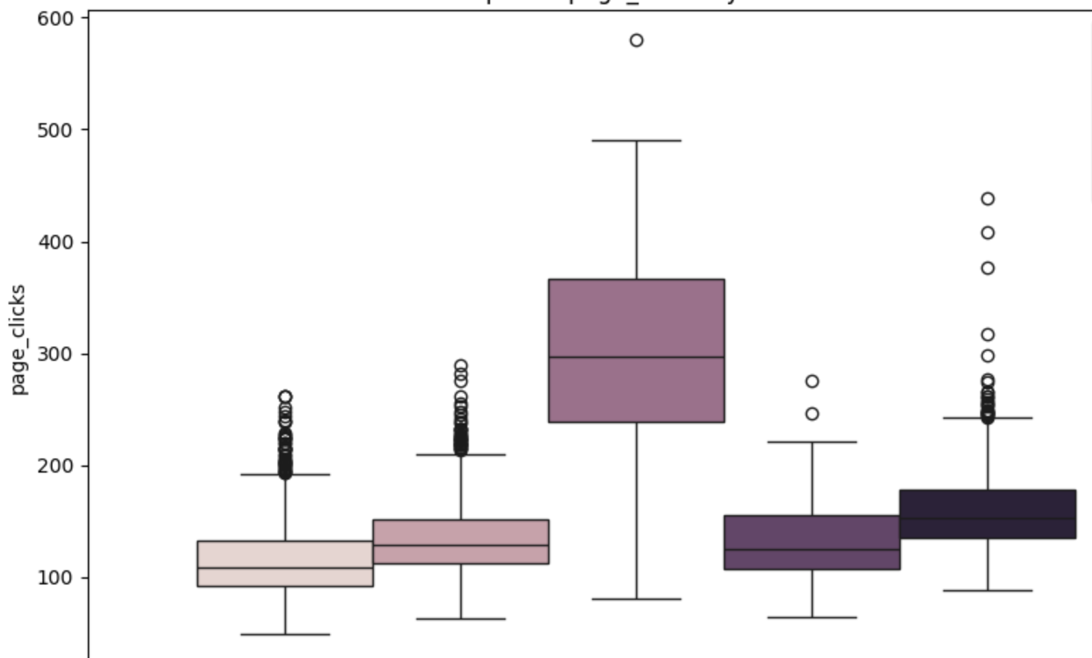
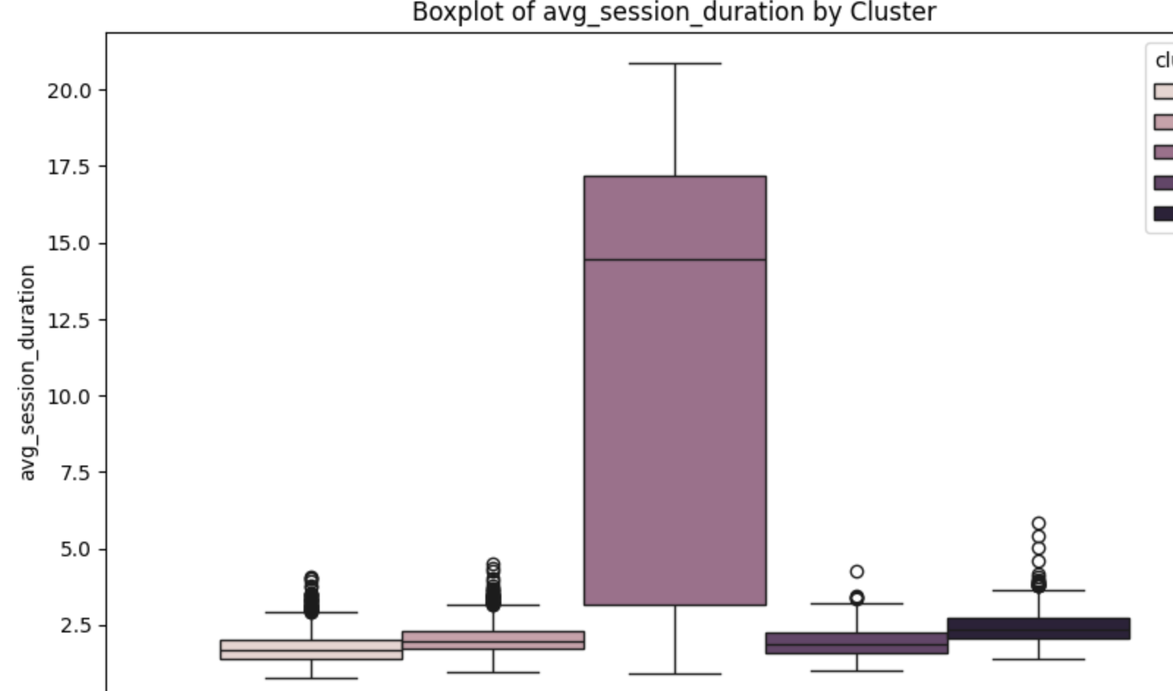
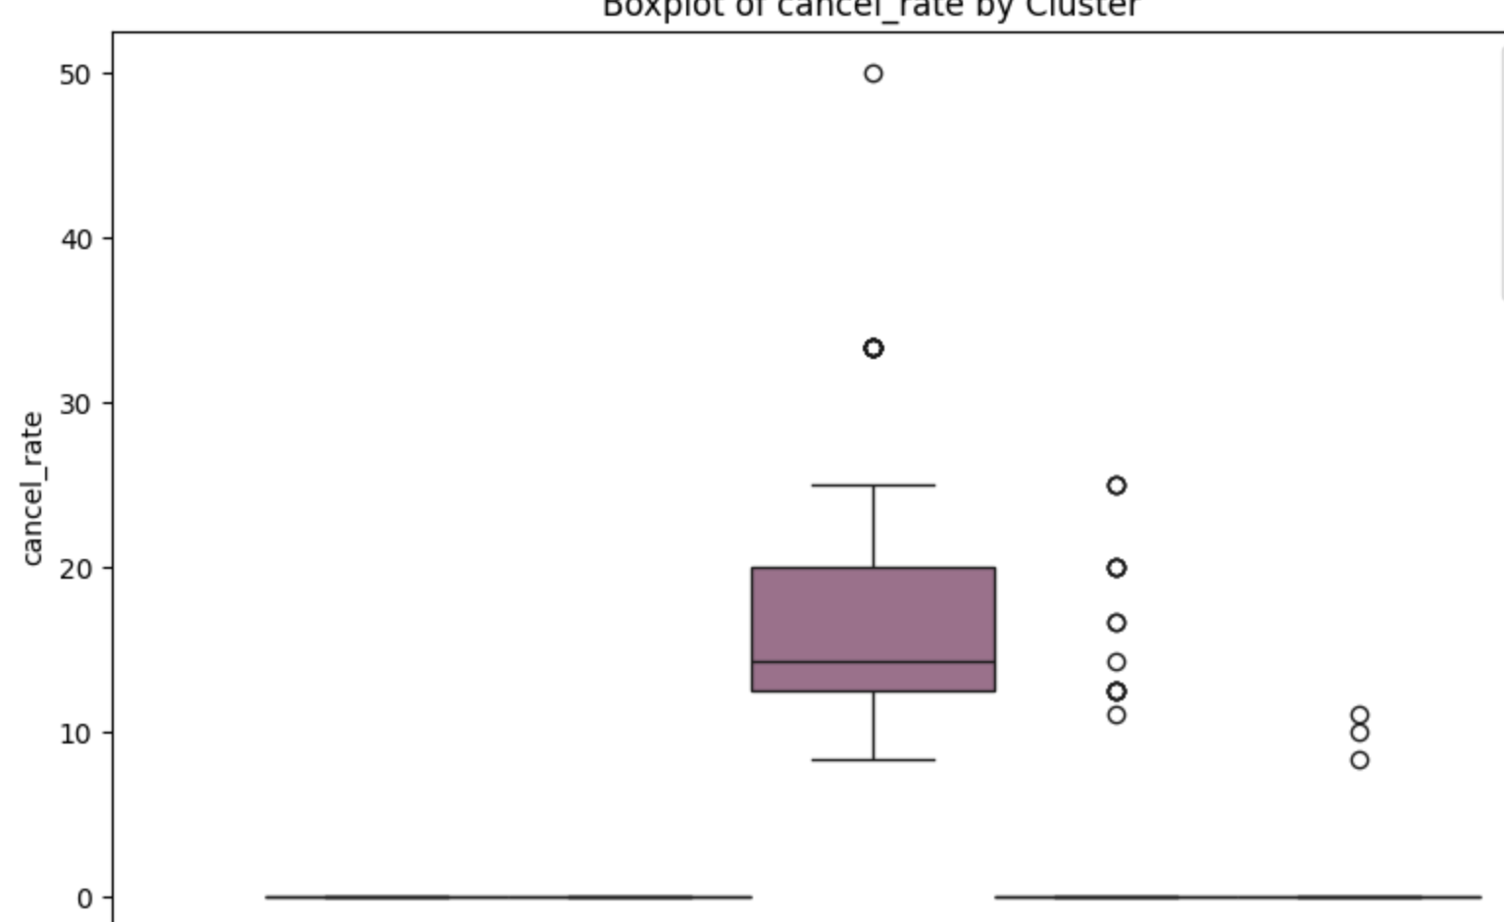
Results: Platform interaction
Page Clicks
Low Engagement (Cluster 0)
Moderate Behavior
(Cluster 1)
High Spenders (Cluster 3)
High Interest
(Cluster 2)
Frequent Travelers
(Cluster 4)
Session duration (min)
Cancel rate
Clusters

Slide 5
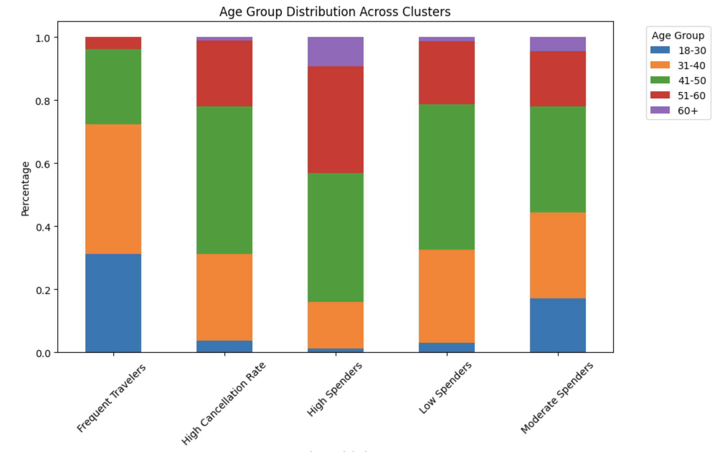
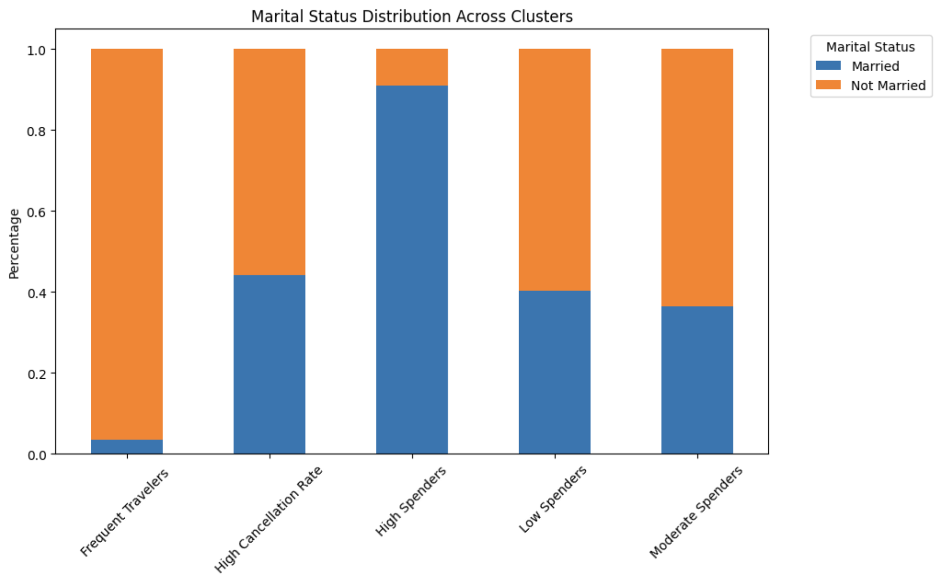
Results: Demographic insights
Age distribution per cluster
60 +
51- 60
41- 50
31- 40
18-30
Marital status per cluster
Frequent
travelers(C2)
High
interest (C4)
High
spenders (C1)
Moderate
behaviour (C3)
Low
engagement (C0)
Not married
Married
Frequent
travelers(C2)
High
interest (C4)
High
spenders (C1)
Moderate
behaviour (C3)
Low
engagement (C0)

Slide 6
Perk assignments
Low Engagement (Cluster 0)
Moderate Behavior
(Cluster 1)
High Spenders (Cluster 3)
Frequent Travelers
(Cluster 4)
High Interest
(Cluster 2)
Free night as
increase bookings.
Free meal hotel
No cancellation fee
Free checked bag
Exclusive discount

Slide 7
Conclusion and future perspective
Conclusion:
The customer segmentation was successfully performed using K-Means clustering and PCA for dimensionality reduction, allowing us to identify five distinct user segments based on their behavior and demographics.
The cluster segmentation allows to assign proper perk to each group
Future Perspectives:
Continuous Monitoring and Updates: User behavior may evolve over time. Re-running clustering analysis periodically will help adapt strategies to changing patterns.
Advanced Personalization: Further segmenting users based on additional factors (e.g., seasonality of bookings, browsing behavior) could enhance the precision of targeted offers.

